Slide 1
Kisaan Kranthi
By
Rachana Aithal
Abijna Rao
K Vennela

Slide 2
What is it?
An API interface with minimal user interface that can be easily incorporated with already established platforms. And this also makes it easily expandable.
Farmers are the sellers who sell their crops directly to the customers without the involvement of any middlemen.
Customers buy the crops from the farmers who are nearby to them at price that is less than the market price.
Builds a farmer community so as to help them learn from each other.

Slide 3
Why go for this?
Customer’s Point of View
Customers who wish to get the fresh, healthy and locally-produced crops at affordable price are just one touch away from finding it.
They will be able to search and get the quality products of their choice from various farmers within the nearby locality in no time.
They will be contributing to and encouraging local farmers

Slide 4
Why go for this?
Seller’s Point of View
They make a better margin for their crops
Simulating local economies
Helping the farmers in increasing their yield and maximizing the profit by suggesting practices that are followed by other farmers
Promoting environmentally, economically, and socially sustainable farming practices
Price Predictor - Intelligent system helps the sellers in determining which types of crops to encourage and plan beforehand.

Slide 5
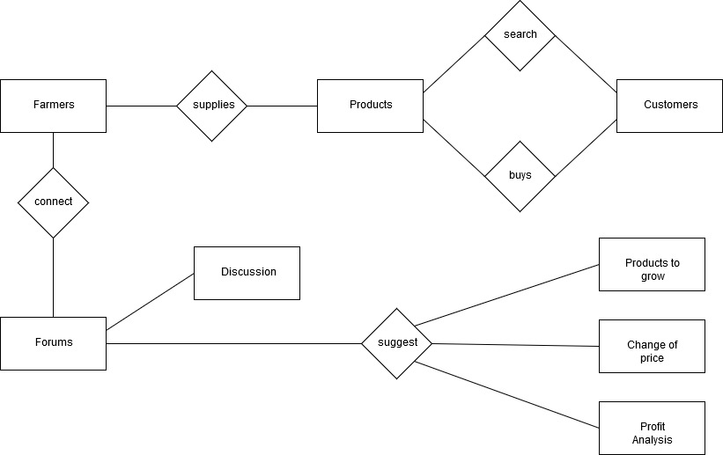
Architecture

Slide 6
Notable Segments - 1. All APIs are available
The Frontend and the Backend are built independent of each other. So, both are extendable individually.
All the APIs are tested for and hence can be used as a backend by third-party UI as well.

Slide 7
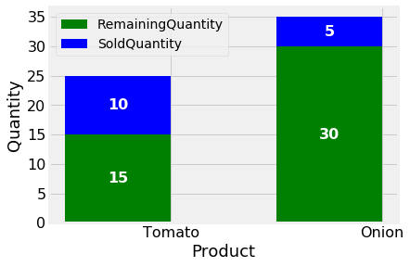
Notable Segments - 2. Farmer DashBoard
Farmer DashBoard is built to provide insights to the Farmer.
It provides various functionalities like
Searching for a product to see how much other farmers are making for the same.
Viewing what practices are employed by farmers with similar land to earn more money.
Viewing a chart to see how much of each batch by the farmer was sold and how much was left behind.
The system can be extended to add more functionalities by just creating new api calls.

Slide 8
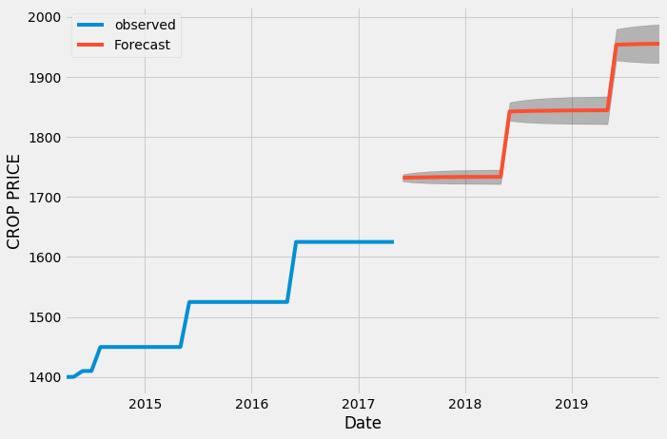
Notable Segments - 3. Price Prediction
The Price Prediction system is built using Seasonal ARIMAX
The system is built on Wheat prices from a district in Punjab.
The prices from different markets in a district is considered because prices vary vastly from location to location

Slide 9
Future Extensions:
Weather Forecast to alert farmers in case of sudden changes in weather that might affect their crops.
The Farmer DashBoard can include more insights like amount earned by nearly farms with the help of Heatmaps.
The application can include tracking of the delivery to establish trust with the customers.
Dynamic Pricing based on the expiry date.

Slide 10
Thank You.
By:
Abhigna Rao
K Vennela
Rachana Aithal K R

